Slide 1
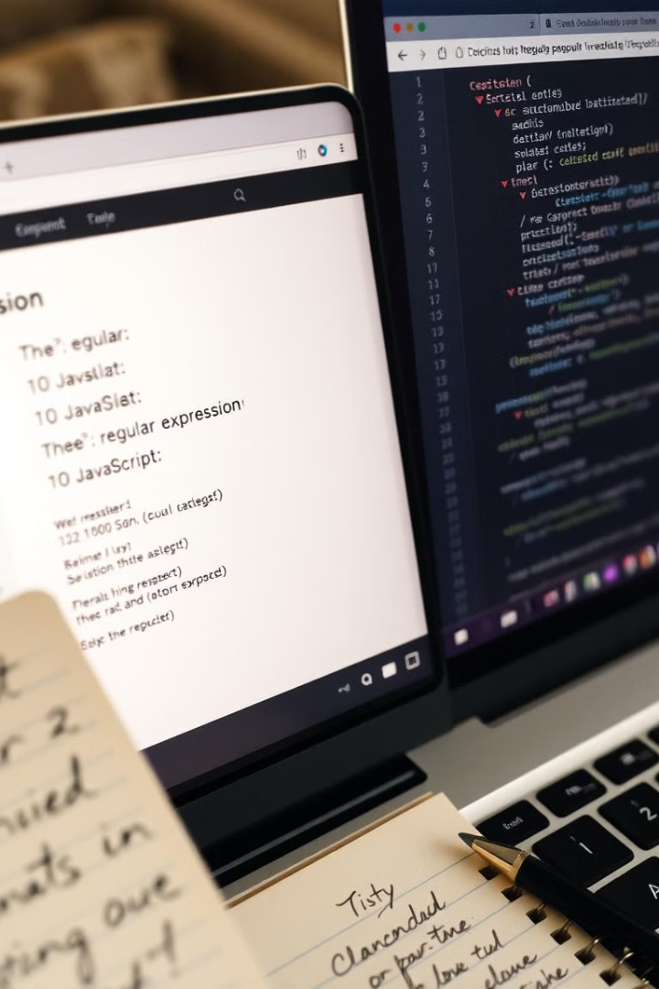

Regular Expressions in JavaScript
Understanding RegExp, Patterns, Modifiers, and Methods
by muniba khan

Slide 2
What are Regular Expressions?
Regular Expressions (RegExp) are patterns. They are used to match character combinations in strings.
They help in searching, replacing, and validating text efficiently.
They're used in form validation, search functionalities, and text processing.
let pattern = /hello/;
console.log(pattern.test("hello world")); // true
Search
Replace
Validate
Find specific text.
Change the text.
Ensure the text is correct.

Slide 3
RegExp Object in JavaScript
JavaScript provides the RegExp object to work with regular expressions.
There are two ways to create a RegExp object:
Literal notation: /pattern/
RegExp constructor: new RegExp("pattern")
let regex1 = /test/;
let regex2 = new RegExp("test");
1
Literal Notation
2
Constructor
Simple and concise.
More flexible.

Slide 4
Matching Patterns in JavaScript
test() method: Checks if a pattern exists in a string.
match() method: Returns matched values.
let text = "JavaScript is awesome!";
console.log(/JavaScript/.test(text)); // true
console.log(text.match(/awesome/)); // ["awesome"]
test()
match()
Returns a boolean.
Returns an array.

Slide 5



Modifiers in Regular Expressions
Modifiers change how regex behaves.
Common Modifiers:
i → Case insensitive match.
g → Global match (find all matches).
m → Multiline matching.
let str = "Hello hello HELLO";
console.log(str.match(/hello/gi)); // ["Hello", "hello", "HELLO"]
Case Insensitive
Global
Multiline
Match upper and lowercase.
Find all matches.
Match across multiple lines.

Slide 6
Brackets in Regular Expressions
Brackets ([]) define character sets.
[abc] → Matches any a, b, or c.
[0-9] → Matches any digit.
let text = "cat, bat, mat";
console.log(text.match(/[cb]at/g)); // ["cat", "bat"]
[abc]
1
Character set.
2
[0-9]
Any digit.

Slide 7





Metacharacters in Regular Expressions
Special symbols are used in patterns.
. → Matches any character.
^ → Matches start of a string.
$ → Matches end of a string.
\d → Matches any digit (0-9).
\s → Matches whitespace.
let text = "abc 123";
console.log(text.match(/\d+/g)); // ["123"]
.
Any character.
^
Start of string.
$
End of string.
\d
Any digit.
\s
Whitespace.

Slide 8




RegExp Properties and Methods
exec() → Returns matched array or null.
test() → Returns true or false.
source → Returns regex pattern as a string.
flags → Returns regex modifiers.
let regex = /hello/g;
console.log(regex.source); // "hello"
console.log(regex.flags); // "g"
exec()
1
test()
2
4
flags
3
source

Slide 9




Uses of Regular Expressions
✔ Form validation (email, phone number, password).
✔ Search and replace text in strings.
✔ Data extraction from text.
✔ Input sanitization.
let email = "test@example.com";
let pattern = /^[a-zA-Z0-9._%+-]+@[a-zA-Z0-9.-]+\.[a-zA-Z]{2,}$/;
console.log(pattern.test(email)); // true
1
Validation
2
Search
3
Extraction
4
Sanitization

Slide 10
Conclusion
Regular expressions are powerful tools. They're for working with strings.
They help in pattern matching, searching, and replacing text.
Learn regex to improve text processing in JavaScript!
Thank You!
1
Learn Regex
2
Improve Skills
3
Be Productive

